Slide 1
MGV Database: Extracting Connector Protein

Slide 2
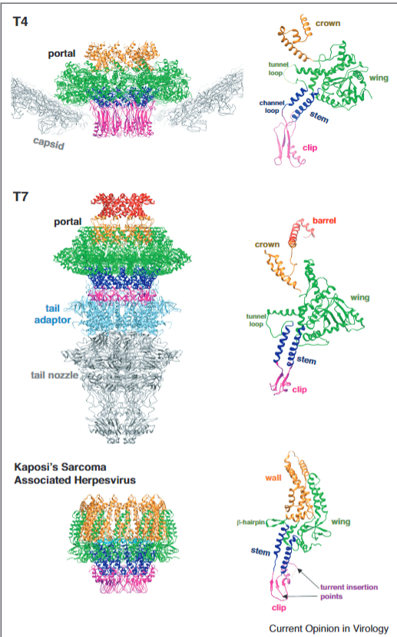
Goal
Find connector protein sequence
Simulate sequences
Improve understanding of the general connector protein structure
Eventual goal: We want to simulate the structure of an entire virus

Slide 3
Viral Protein Homology
Connector protein sequences aren’t similar because the phages evolved the protein independently
Common methods of annotating proteins:
- Structural: modelling and comparing
- Sequence: comparing sequence to database
Homology = sequence related because of common ancestor
Similarity = degree of likeness between sequences
Notes:
Similarity often used to deduce homology
Homology indicates an ancient common origin and temporal evolution and refers to structural characteristics
In comparative protein biochemistry, "homology" retains the original meaning of "having a common evolutionary origin" and is used to evolutionarily define two or more proteins by locating common structural characteristics and common spatial distribution of, for instance, beta strands, helices, and folds. Accordingly, homologous protein structures are defined by spatial analyses. Measuring structural homology involves computing the geometric–topological features of a space. One approach used togenerate and analyze three-dimensional (3D) protein structures is homology modeling (also called comparative modeling or knowledge-based modeling). Homology modeling works by finding similar sequences on the basis of the obvious fact that 3D similarity reflects 2D similarity. Nonetheless, it is important to note that homologous structures do not imply sequence similarity as a necessary condition.
Sequence identity is the amount of characters which match exactly between two different sequences. Hereby, gaps are not counted and the measurement is relational to the shorter of the two sequences.
This has the effect that sequence identity is not transitive, i.e. if sequence A=B and B=C then A is not necessarily equal C (in terms of the identity distance measure) :
https://www.novoprolabs.com/support/articles/what-is-the-difference-between-homology-similarity-and-identity-201803011302.html

Slide 4
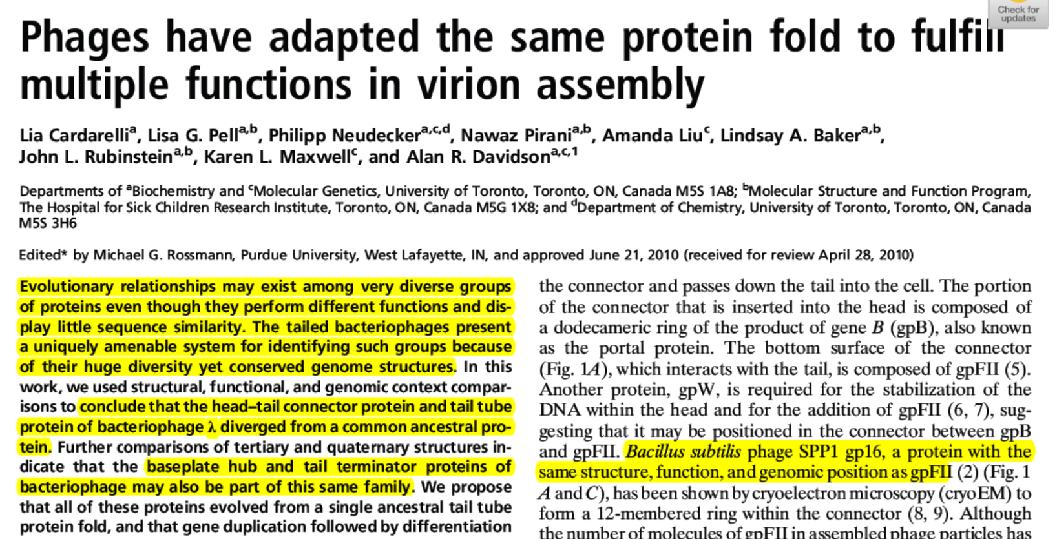
BUT the genomic organization (order of genes) and structure is similar

Slide 5
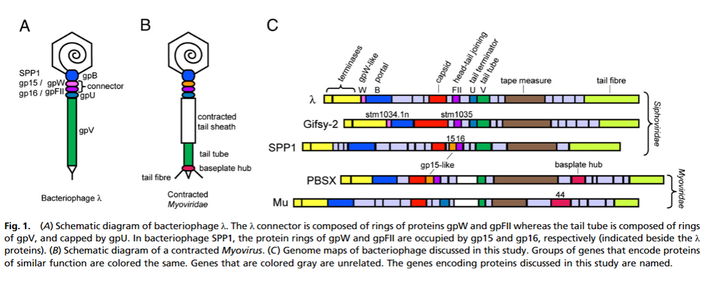
Genome Structure Example

Slide 6
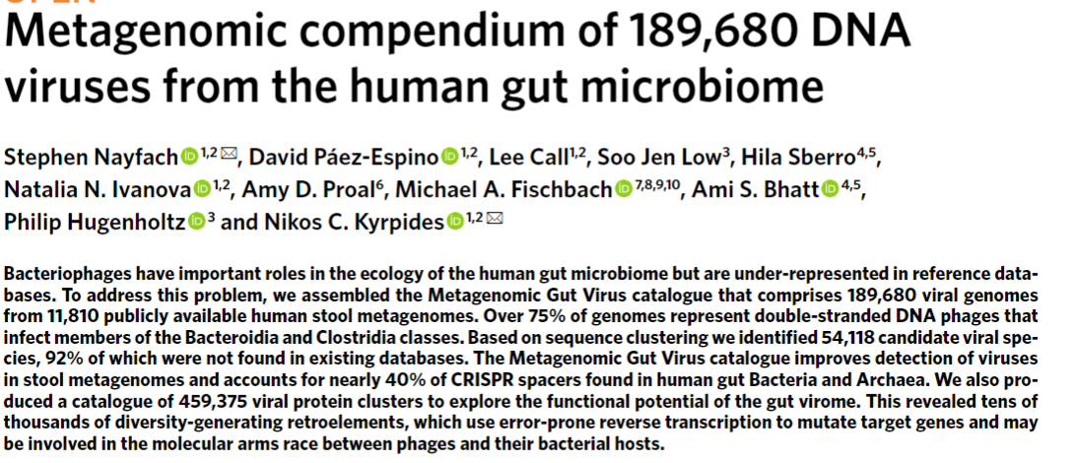
Data
Paper analyzed bacteriophages found in the human gut microbiome
189,680 viral genomes
Found many NEW species
Made a catalogue of viral protein clusters and annotated using HMMER (HMM searches against protein family databases)

Slide 7
Metadata
mgv_contig_info.tsv
Metadata for the 189,680 viral genomes. Fields include:
votu_id: indicate the species-level viral OTU the genome belongs to
checkv_quality: medium quality (50-90% complete), high quality (>90% complete), complete (closed genome)
prophage: wheter or not the contig was flanked by DNA from the host (these regions were removed)
temperate_score: BACPHLIP output indicating the probability the virus lives a temperate lifestyle
virulent_score: BACPHLIP output indicating the probability the virus lives a virulent lifestyle
completeness: CheckV estimated completeness
gc: GC content
stop_codon_readthrough: indicates whether the virus is predicted to read through a particular stop codon
baltimore: baltimore classification
ictv_order, ictv_family, ictv_genus: annotations based on the ICTV taxonomy
Notes:
BACPHLIP detects the presence of a set of conserved protein domains within an input genome and uses this data to predict lifestyle via a Random Forest classifier

Slide 8
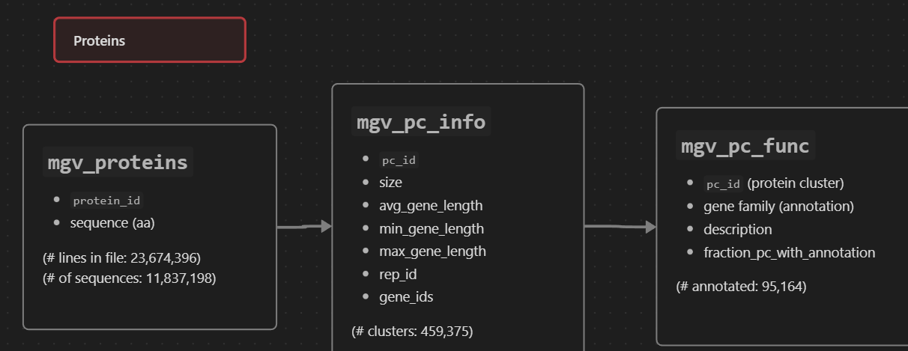
Data

Slide 9
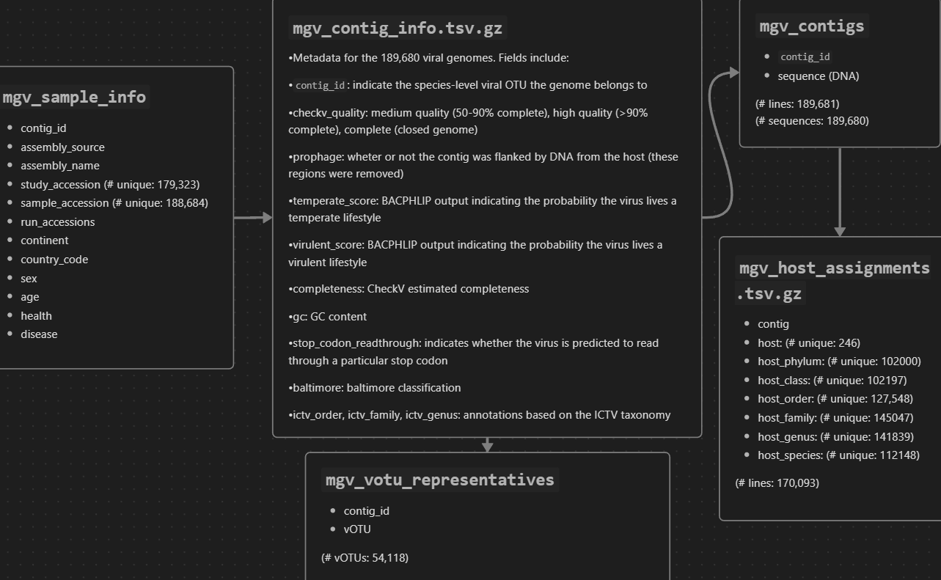
Data
Baltimore Classification:
7 classes based on nucleic acid (DNA / RNA), strandness (double / single), sense, method of replication

Slide 10
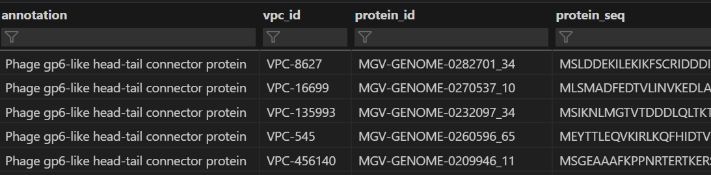
Annotations in Dataset
Paper:
Clustered data using MMseq2
Annotated 20% using HMMER:
HMMER: detects homology by comparing a profile-HMM (a Hidden Markov model constructed explicitly for a particular search) to either a single sequence or a database of sequences.
Pfam:
collection of protein families (MSA and HMMs)
Results
411 portal proteins
146 connector

Slide 11
Workflow
Find connector protein domain (in literature / NCBI)
BLAST
Filter alignment results by e-value (want very low e-values and high bit scores)
Have to make decisions based on the data
Check if the proteins are annotated / clustered (mgv_pc_info.tsv.gz)
Model some proteins in list / cluster (to make sure the results are correct)

Slide 12
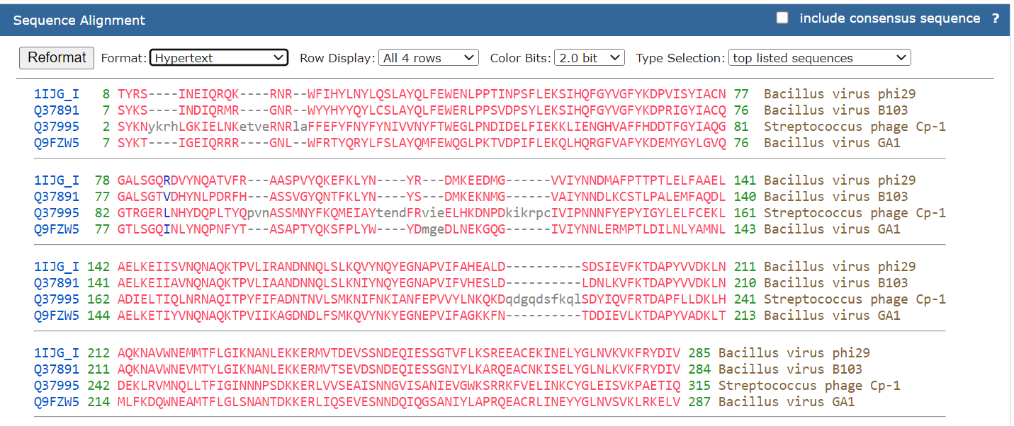
1. Connector Domain
Used Phage connector domain (from NCBI)
Did BLAST: ~520 sequences
Filtered by e-value: 2e-60 as a threshold (was just the highest “significant” e-value)
Found protein cluster (in database) that matched most of the BLAST outputs (5464 sequences)

Slide 13
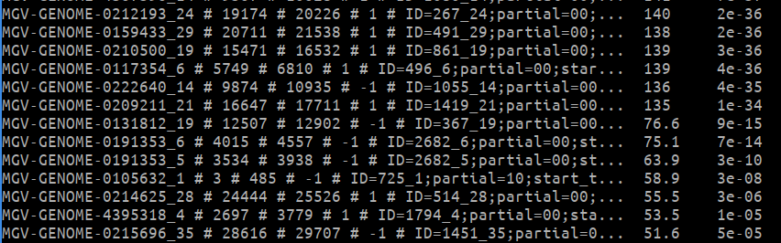
2&3. BLAST
Here, I chose a point when the Bit score drops off
After checking if the results correspond to any protein clusters, I found VPC_8016, which has exactly the same number of proteins in the cluster as there are in the BLAST results (269 proteins)
E-value = number of expected hits of similar quality (score) that could be found just by chance
Bit score = size of database you would need to see an alignment by chance
You want smaller e-values and larger bit scores

Slide 14
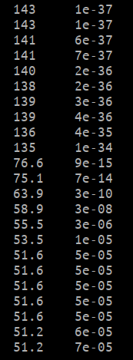
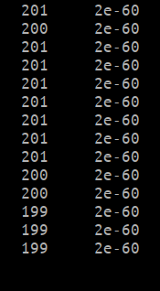
2&3. BLAST

Slide 15
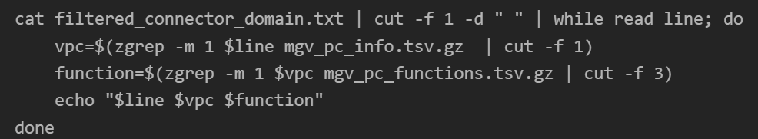
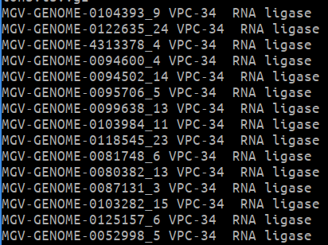
4. Check for annotation
The BLAST results (using the connector domain as a query) match the RNA ligase annotation for some reason

Slide 16
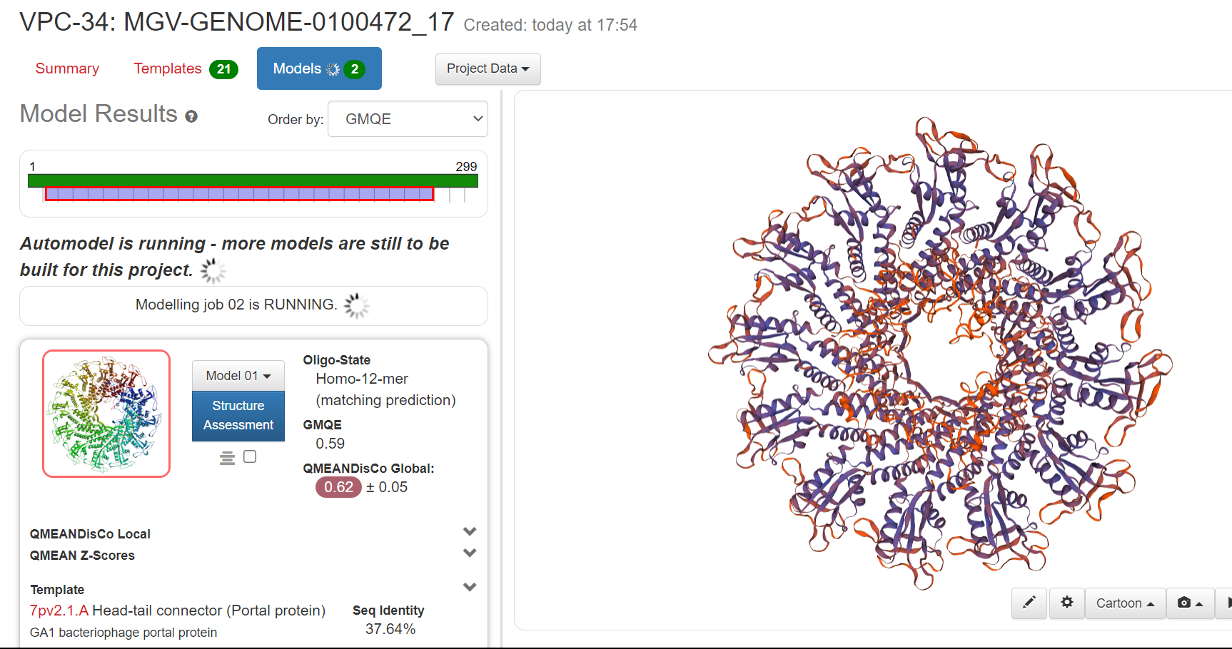
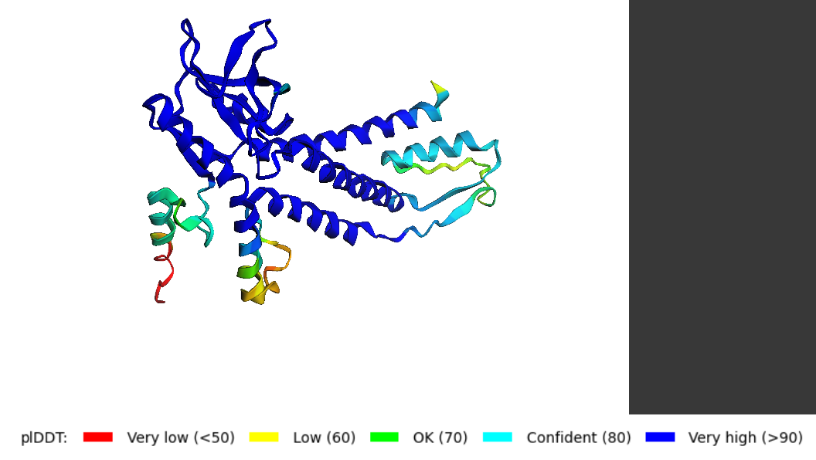
5. Modelling
Modelled some of the proteins found in the protein cluster (VPC-34)
Result:
AlphaFold:
Swiss-MODEL:

Slide 17
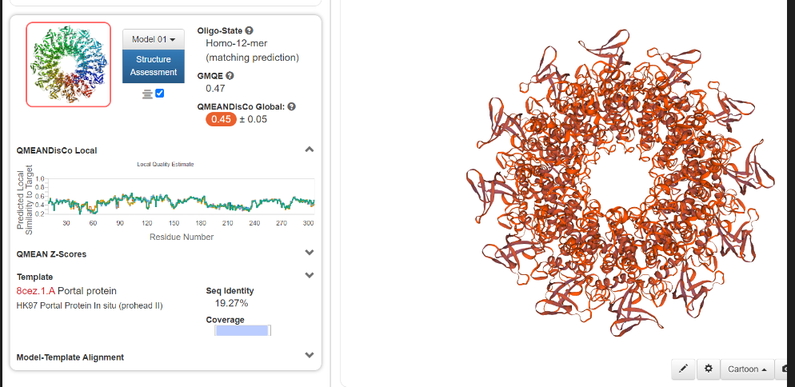
Query Sequence
>YP_010091615.1 portal protein [uncultured Caudovirales phage]

Slide 18
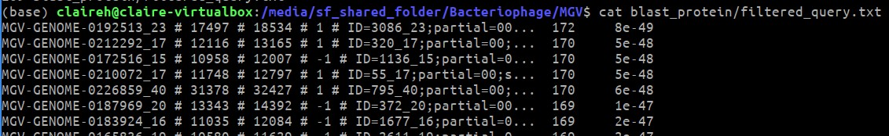
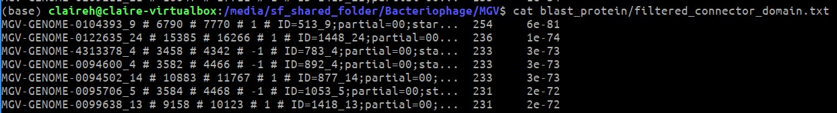
BLAST: Query Sequence
- BLAST results using query sequence aren’t quite as good as using connector domain but they’re still good

Slide 19
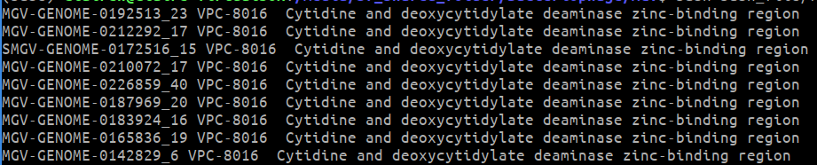
Query Seq. (cont)
Annotation

Slide 20
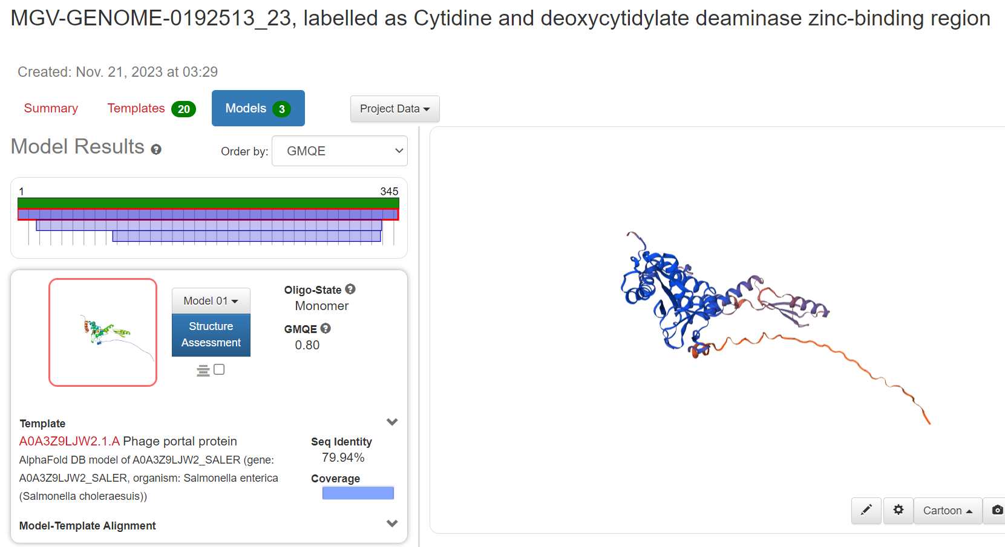
Query Seq. (cont)

Slide 21
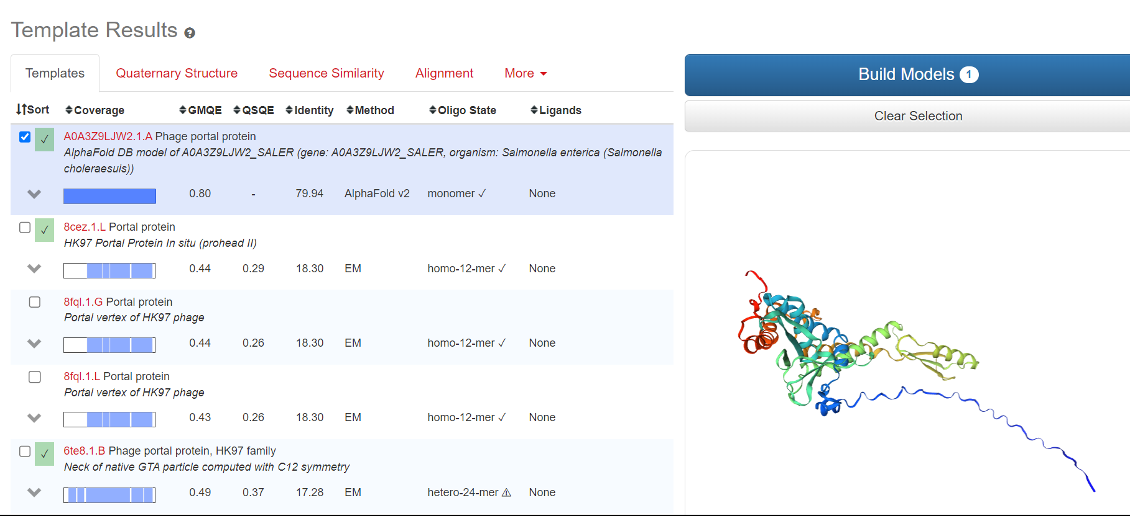

Slide 22
Ideas for how to find the rest of the connector sequences
ML Programs for Protein Annotation:
http://phanns.com/
Doesn’t work? Problem with FASTA headers
http://prodata.swmed.edu/MESSA/MESSA.cgi
Need query organism?
Looking at protein structure

